Slide 1
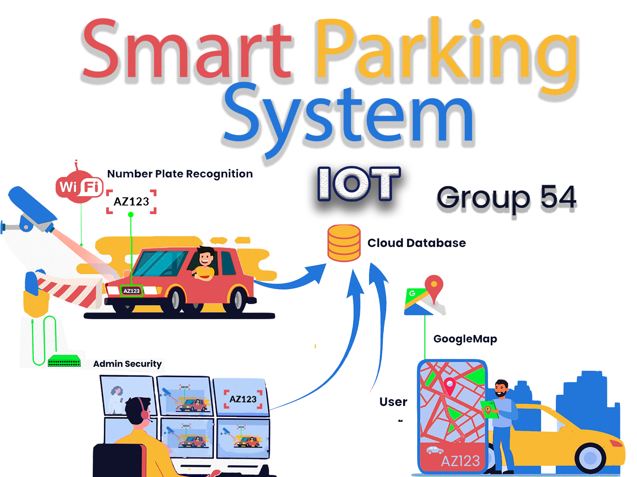

Slide 2


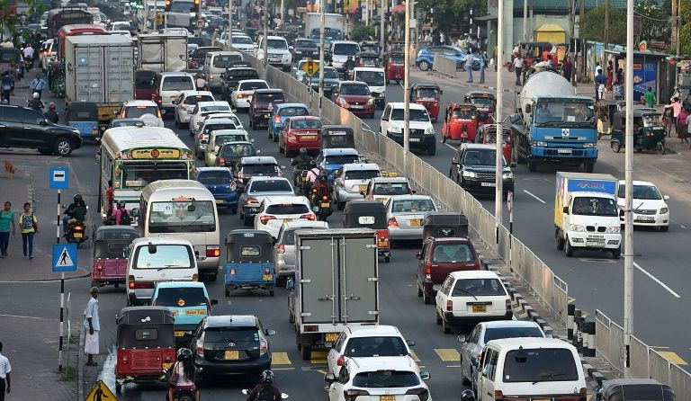
Introduction
There is almost no space for parking, and they are bit difficult to find. This system can Identified Primarily by the number plates of the vehicles which obtain the driver details. Almost drivers can use any parking space from one place .
Key features
Everything is monitored from the moment the vehicle enter the park.
Security can Open to gate for Successfully vehicles
Desktop Application can add new parking location ,and it can change every Mobile database value.
Drivers can view the available spots and guidelines for parking .
Camera provide the security and the l monitoring vehicle.
Arduino bord LED panel is showing vehicle parking status.
Google map Using driver can navigate parking locations.
Database for using Docker Container with MySQL .
Chat system is Using to Connect with Security

Slide 3
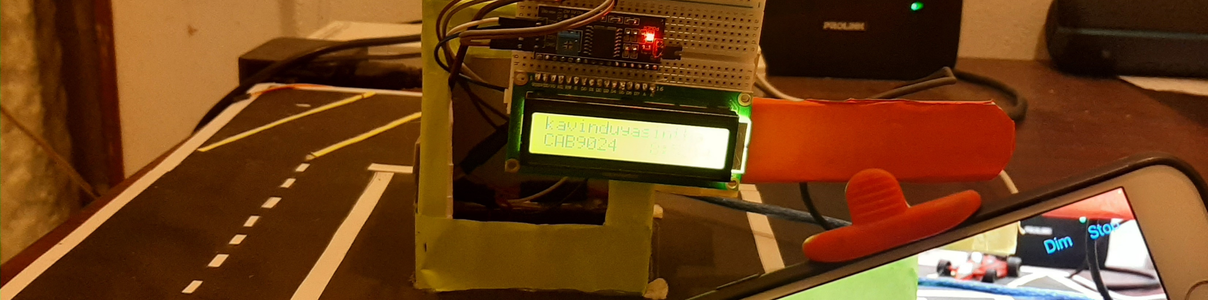
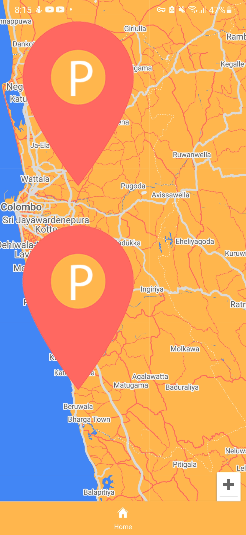
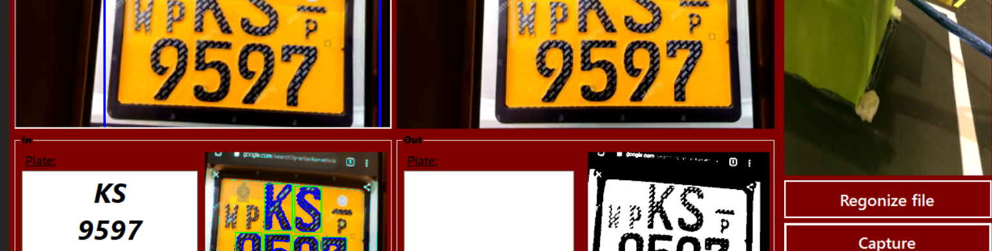
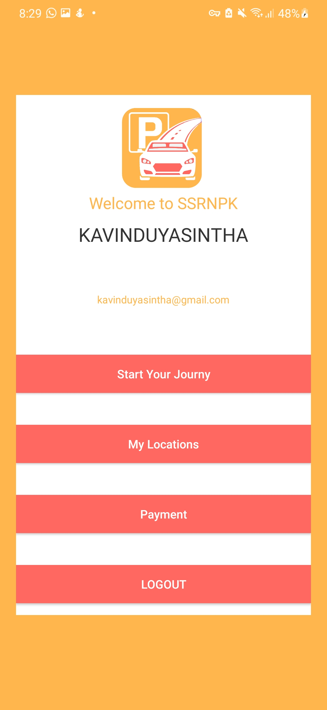
Design and Implementations

Slide 4
Parking system
Mobile Application
Desktop Application
Hardware System
Login /Registration
QR Scan and Payment
Parking Slot Oder
Google Map
Image Preceding System
Admin Controls
Json Responding
Parking barrier
IP Camera .
Azure Cloud Database and PHP Back End

Slide 5
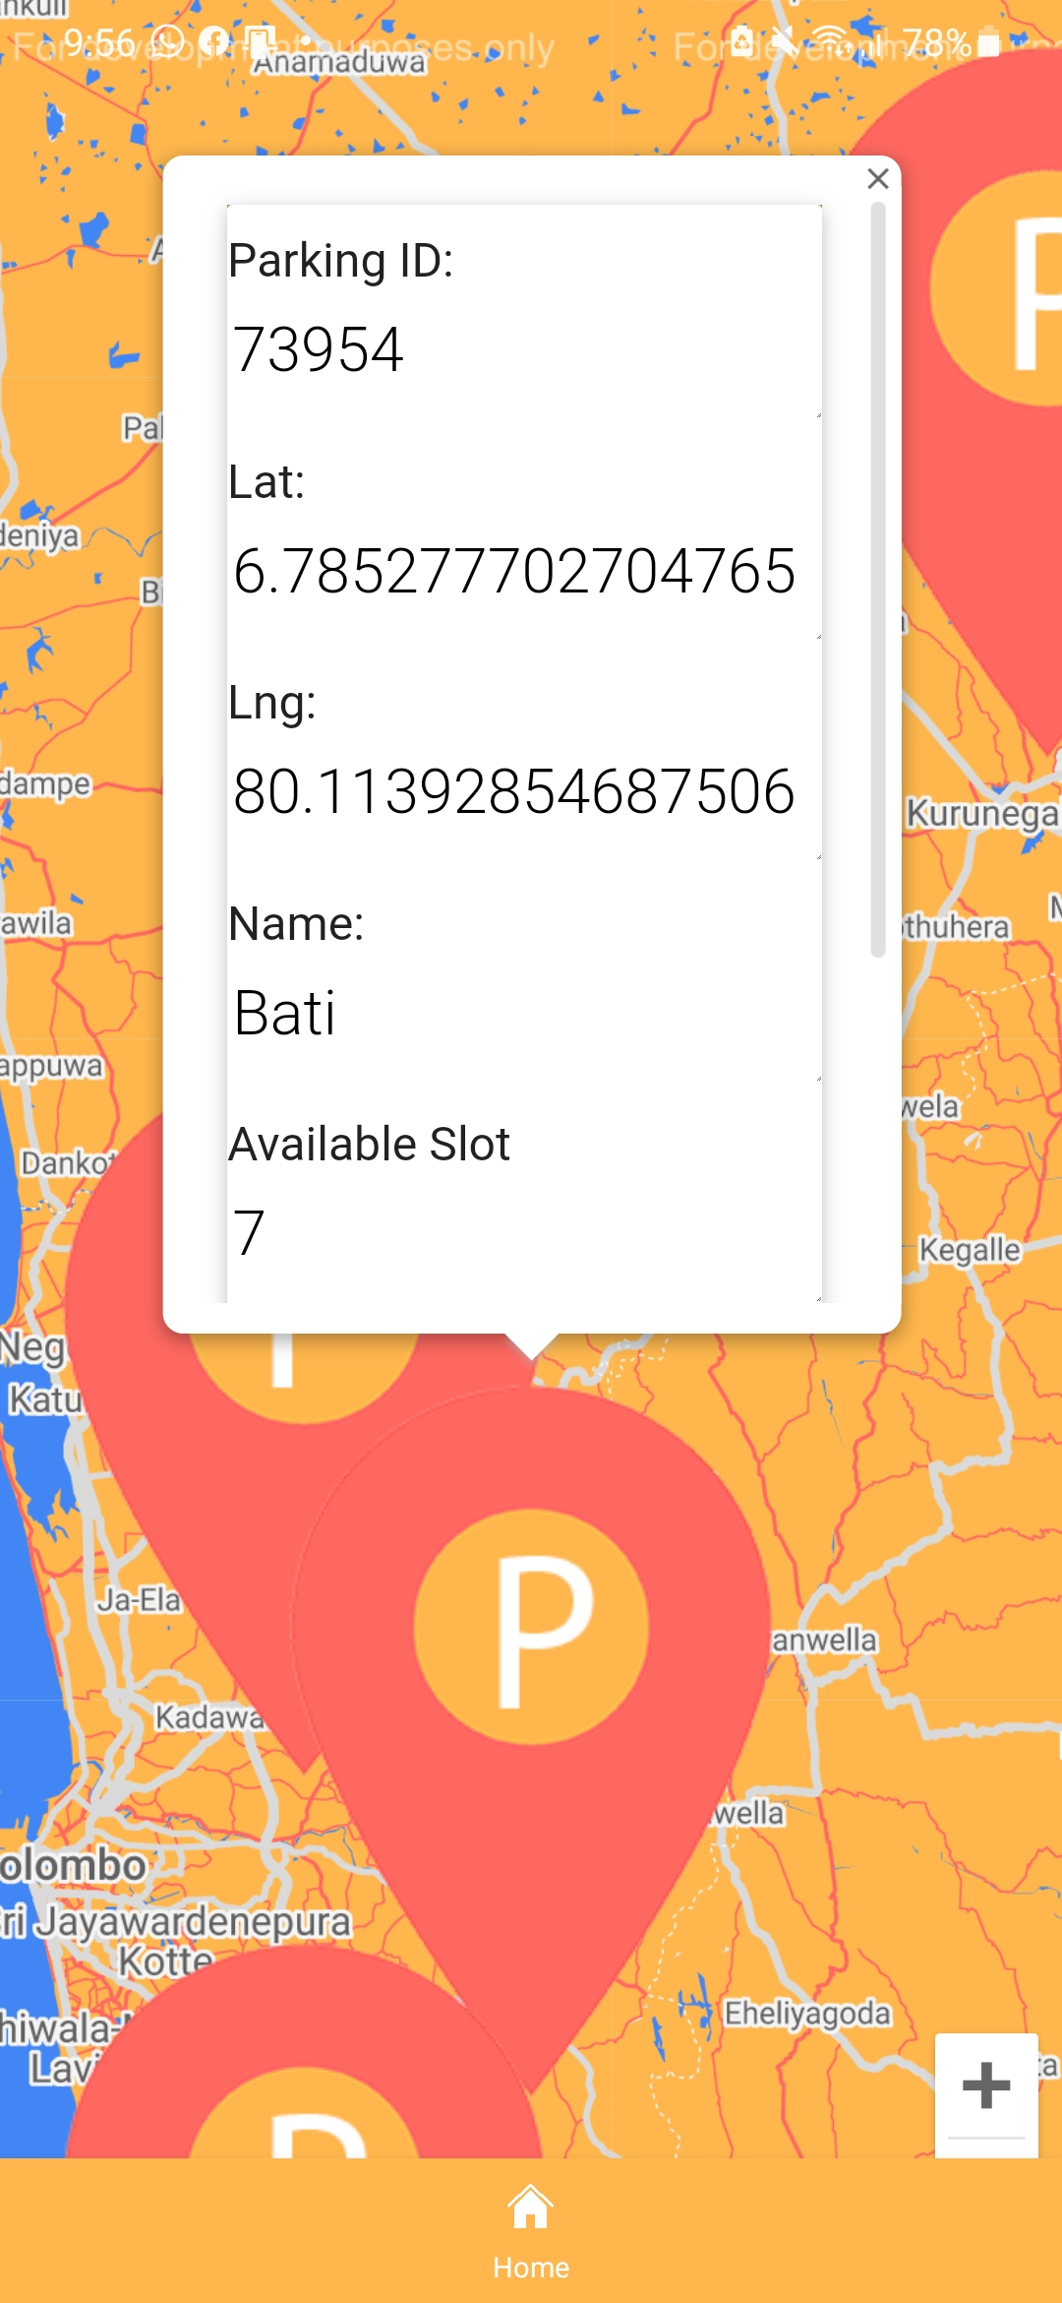
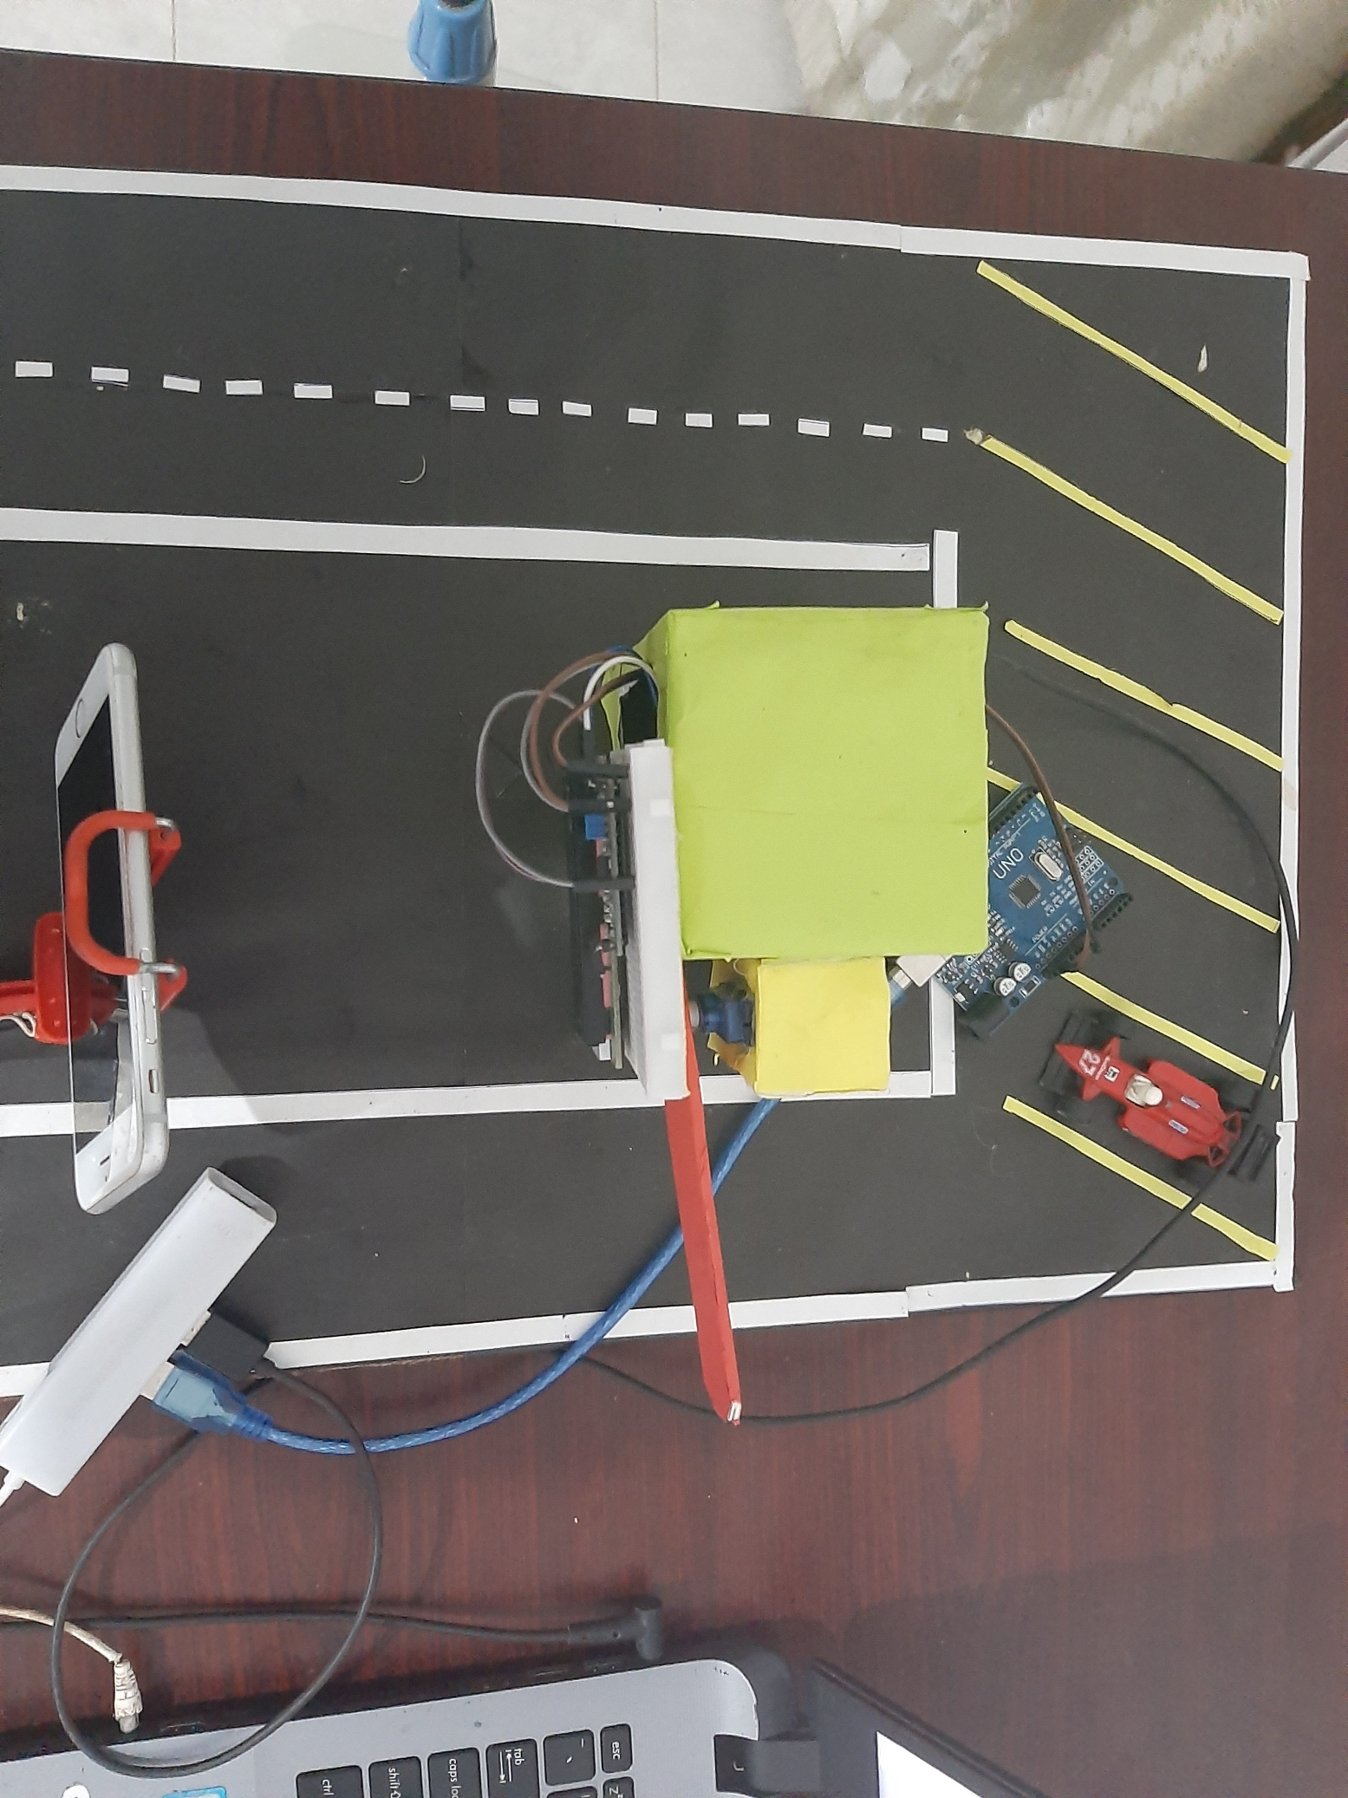
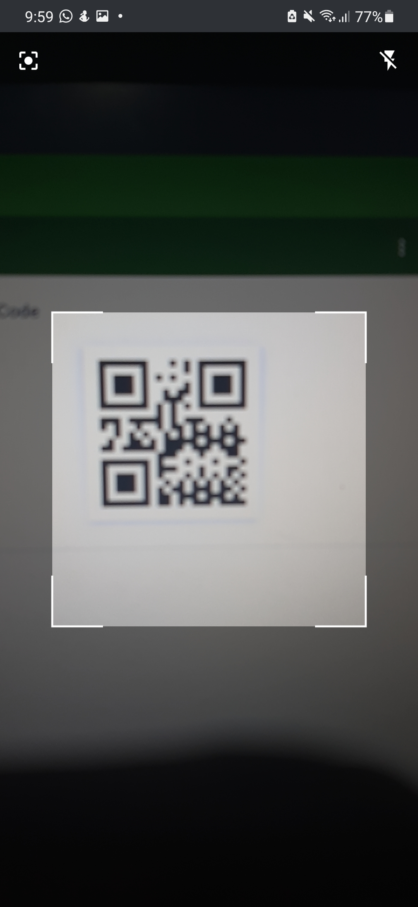
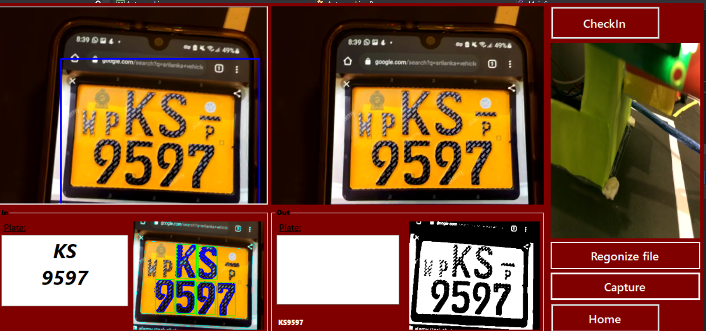
Enter Parking Area
Identify Number Plate Using Image Processing
2
3
Oder parking Slot using mobile application
Payment Use QR code
4
1
Exit
Parking
5

Slide 6

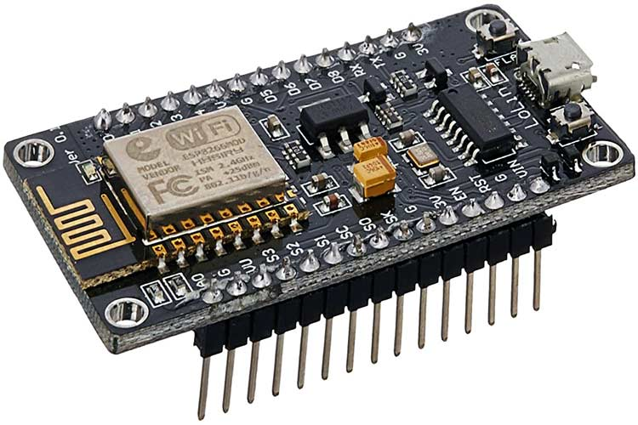
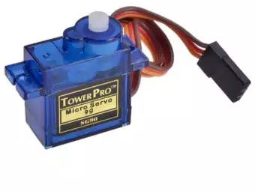
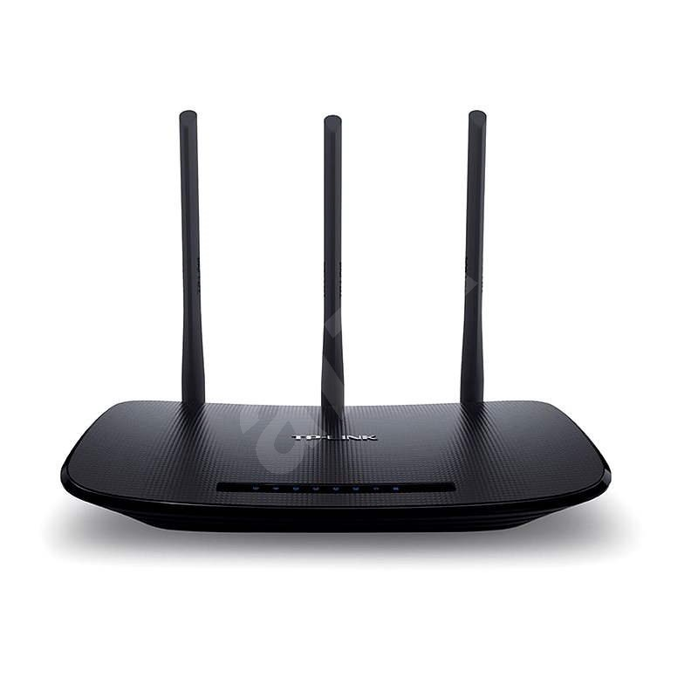
Node MCU esp8266
12V Power
Sever Motor
IP Camera
i2c lcd
Wi-Fi Router

Slide 7
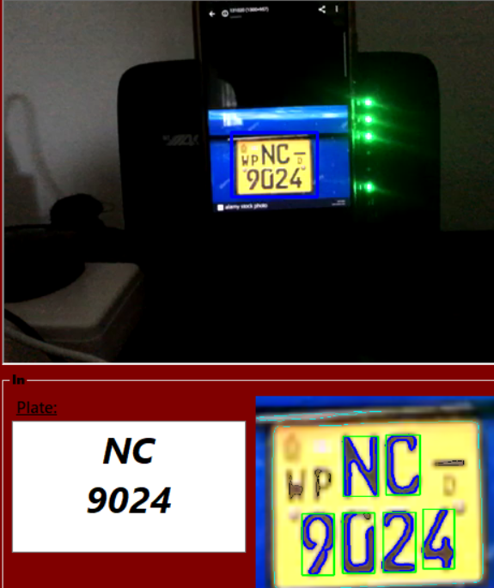
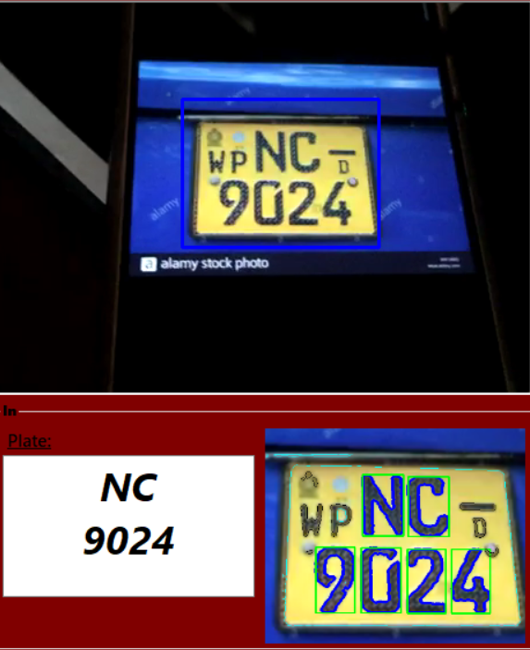
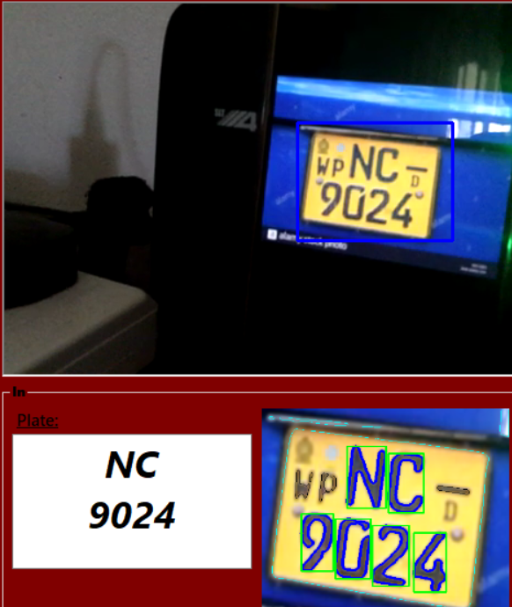
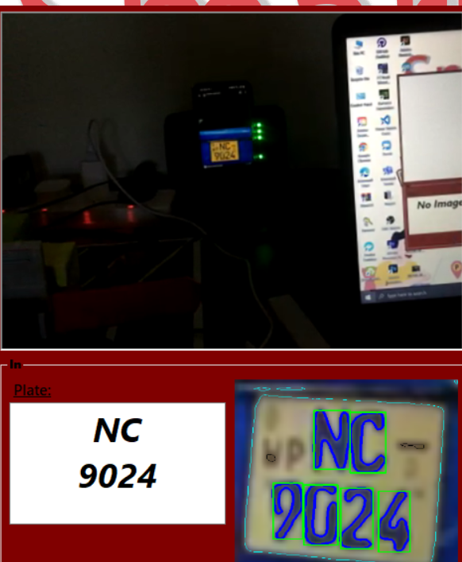

Slide 8
Architect detect Plate (OCR transcription)
Load Image
Characting training
Load training
Image
Pre-Image Processing
Convert to Binary
Get feature data
Draw React around object
training
Find the React we suspect as license plate
Save SMV training file

Slide 9
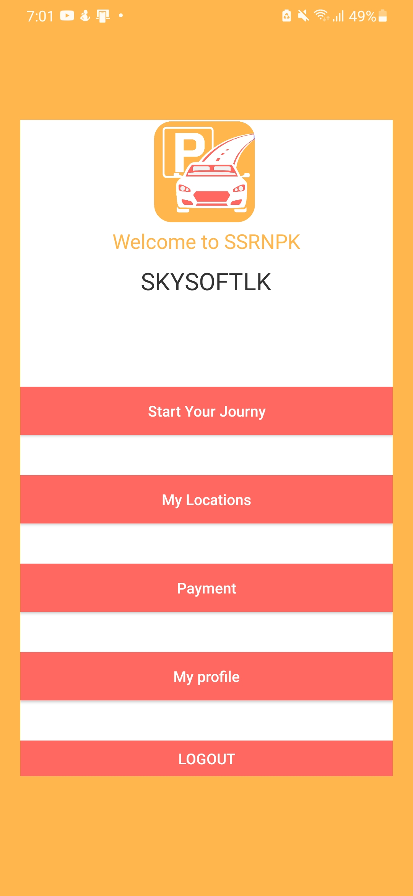
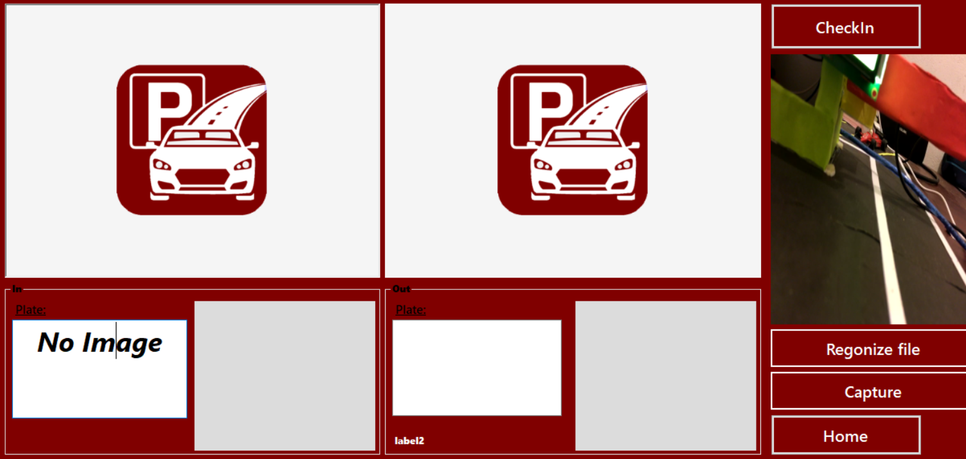

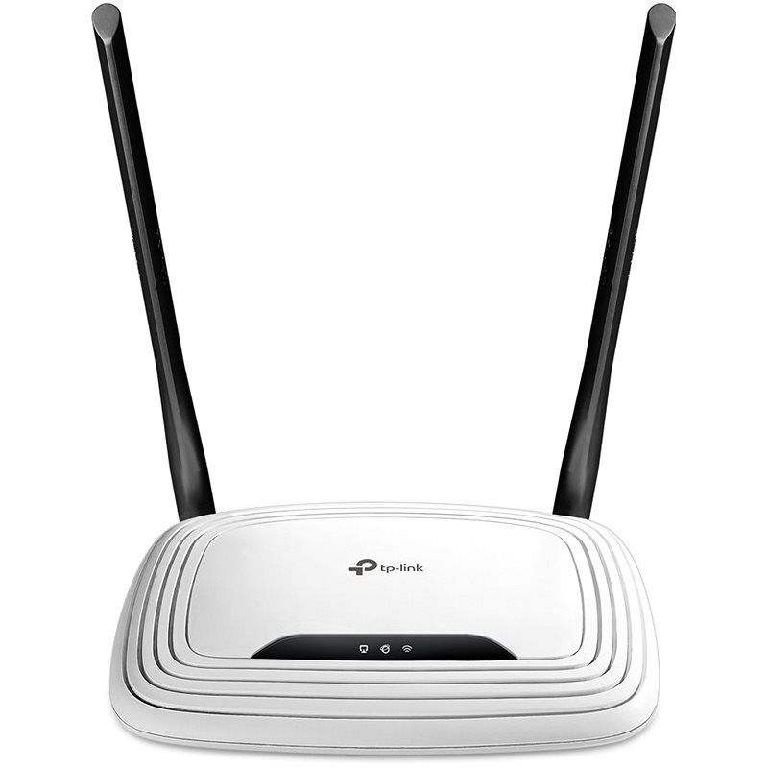

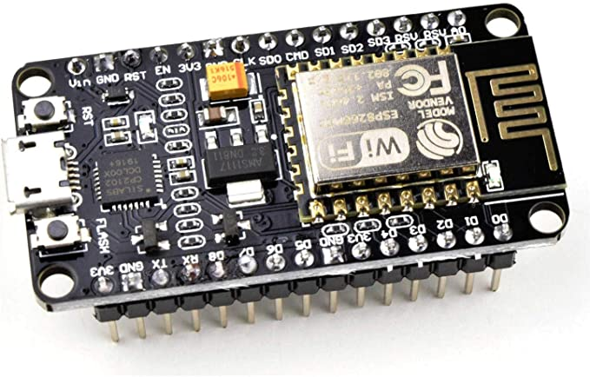
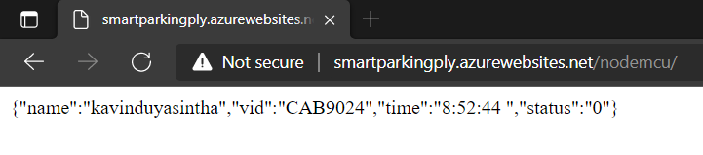
Hardware Components And Connecting with Internet
Desktop Application
Mobile Application
Database
Connecting With Wi-Fi
Http Post
Internet
Wi-Fi Router
Json Response
Node MCU ESP8266
Json

Slide 10
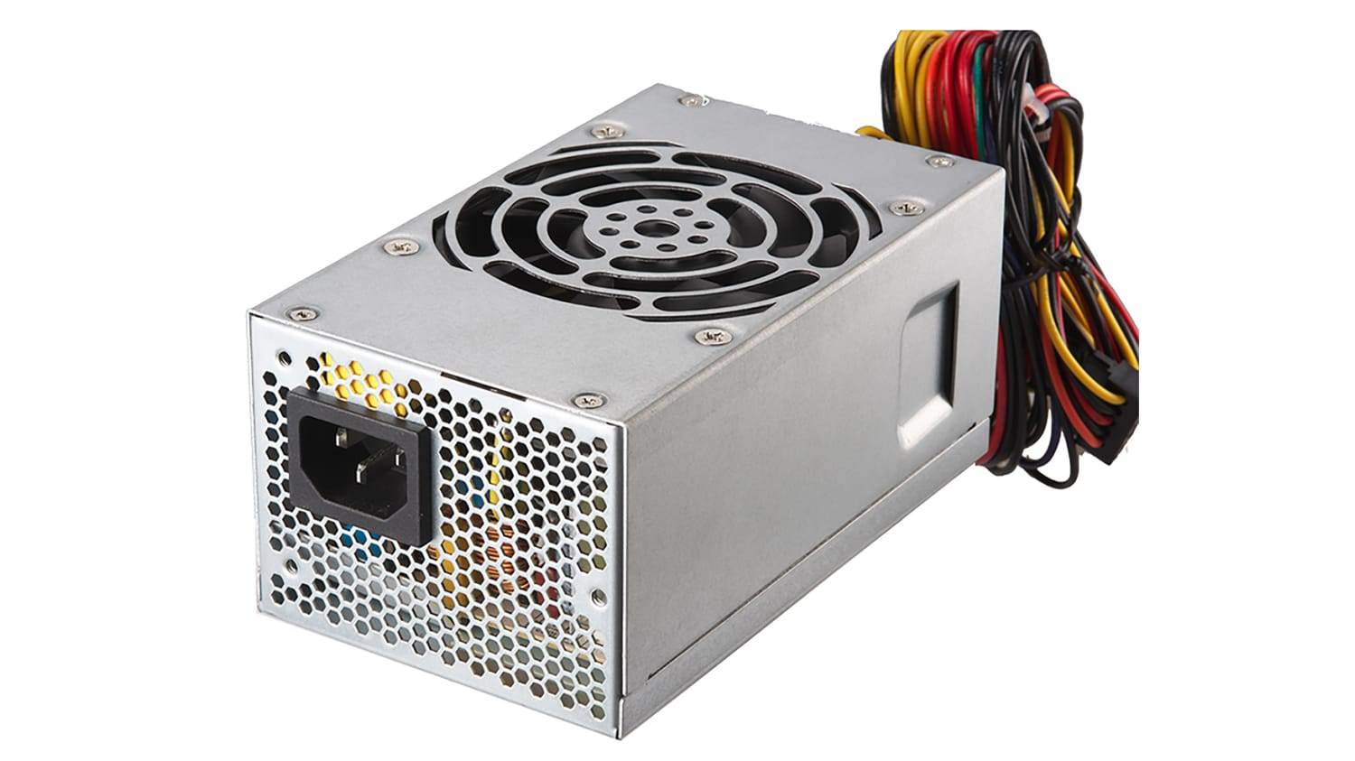
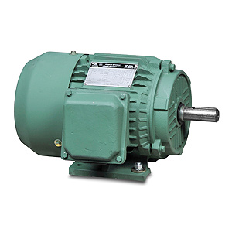
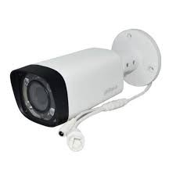
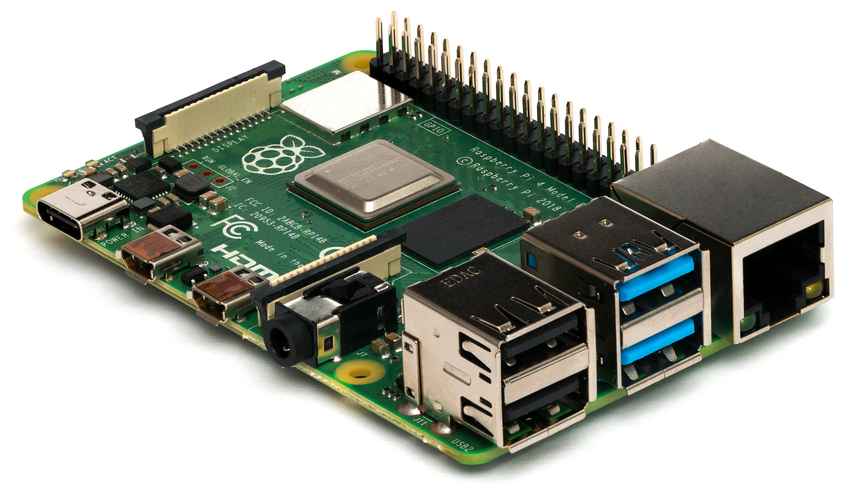
Node MCU esp8266
12V Power
UC Motor
Sever Motor
IP Camera
Further developments
Raspberry pi
i2c lcd
Wi-Fi Router

Slide 11

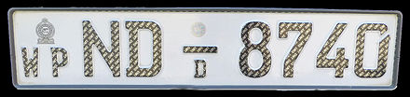

Further developments
Node MCU esp8266
Raspberry pi
We hope to move to splash UI

Slide 12
Date | Test case | Tester | Resalts | Status
2021/1/3 | Login and cardinalities | H.W.N Thathsara | 100% accuracy | Pass
2021/1/4 | Image processing system – identifying image | S.K.Y Silva | Multiple character not identifying | Fails
2021/1/4 | Image processing system – identifying image | S.K.Y Silva | 100% accuracy | Pass
2021/1/6 | Desktop charts and forms test | R.G.K.D Amarasooriya | 100% accuracy | Pass
2021/1/6 | C# OOP class tests | R.G.K.D Amarasooriya | Polymorphism, Inheritance., Encapsulation. | Pass
2021/1/10 | Map locations And database | P.N De Silva | 100% accuracy Data pass with post method | Pass
2021/1/10 | Parking barrier | S.K.Y Silva | Working with database | Pass
2021/1/10 | Payments | P.N De Silva | 100% security | Pass
2021/1/15 | Test database with er diagrams | G.M.S Lakshan | All entity is completing | Pass
2021/1/17 | Data table and remote working | G.M.S Lakshan | http get clients is working 100% | Pass
2021/1/20 | OTP | R.D Paranawithana | 100% accuracy | Pass
2021/2/1 | Level 1 test | S.K.Y Silva, G.M.S Lakshan. R.G.K.D Amarasooriya, P.N De Silva, H.W.N Thathsara, R.D Paranawithana | Retest all above test case and 100% accuracy | Pass
2021/2/5 | Final test | S.K.Y Silva, G.M.S Lakshan. R.G.K.D Amarasooriya, P.N De Silva, H.W.N Thathsara, R.D Paranawithana | 100% accuracy | Pass
Table 3

Slide 13


